Slide 1

Eid al-Fitr
Savonin Maxim ET-111
Popov Danil ET-111

Slide 2
Plan

Slide 3
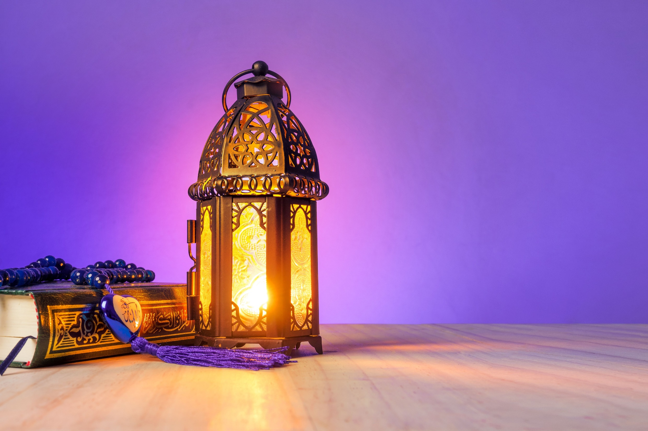
Purpose
Problems
We want to tell for audience about Eid al-Fitr
We haven’t problems☺

Slide 4
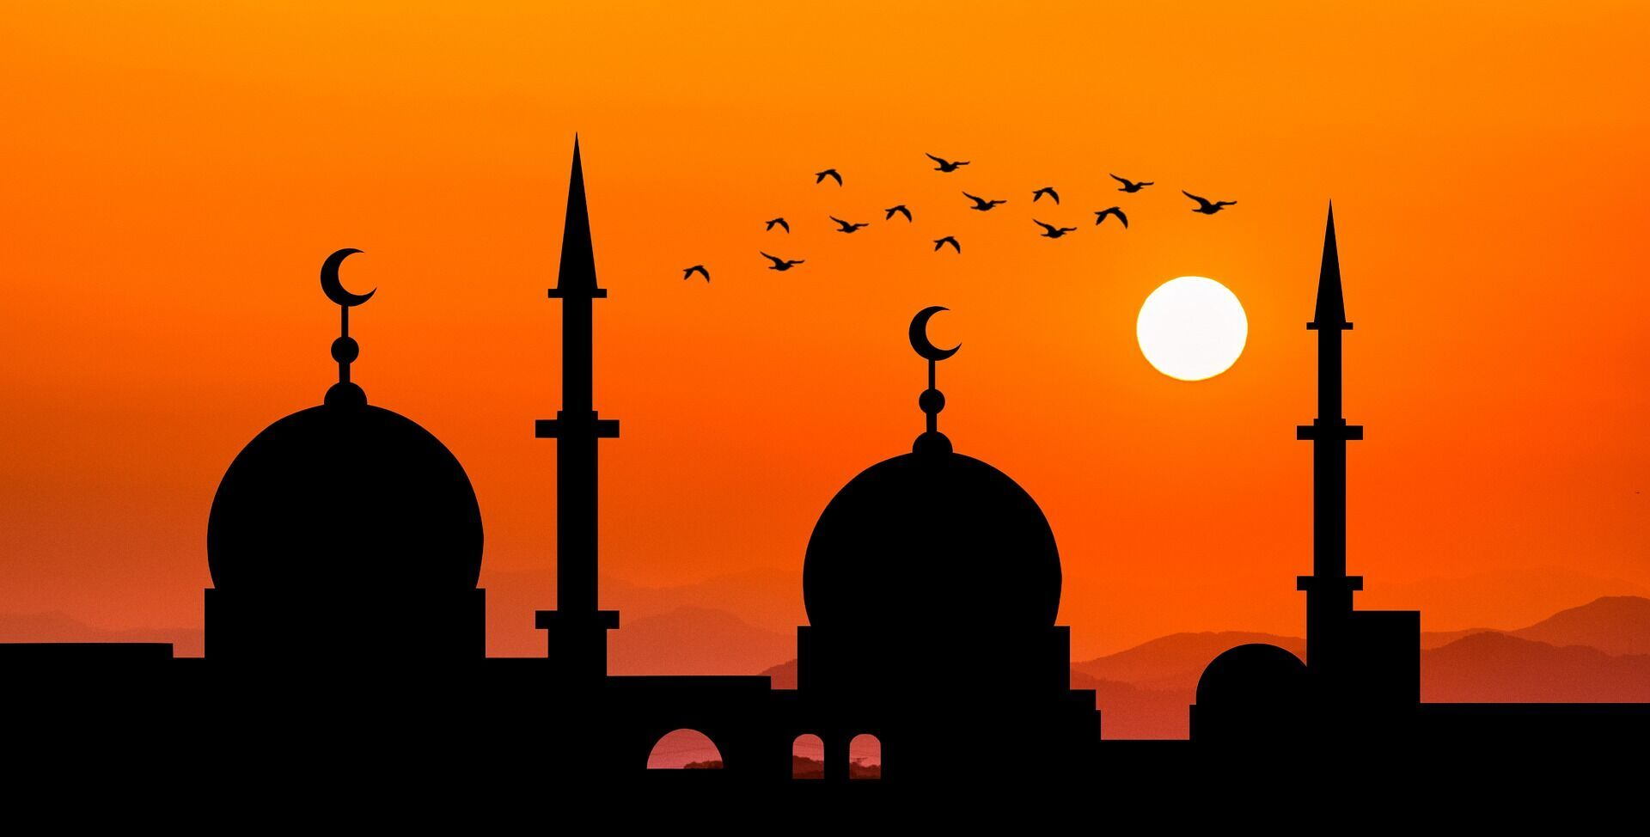
Eid al-Fitr
Eid al-Fitr is an Islamic holiday that is observed by Muslims around the world to mark the end of Ramadan, the Islamic holy month of fasting and prayer.

Slide 5

Eid al-Fitr
Eid al-Fitr, also referred to as the Festival of Breaking the Fast, is a three-day holiday that begins on the first day of the Islamic month of Shawwal. During this festival, Muslims come together to pray, share, and enjoy the blessings of God.

Slide 6
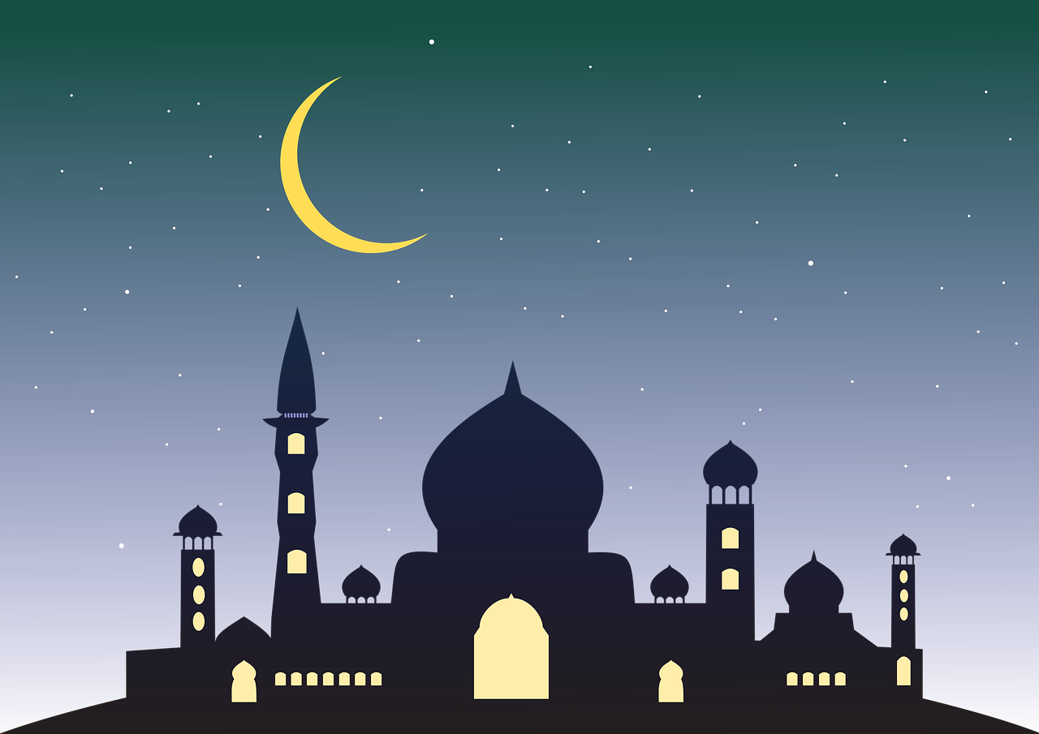
More about Eid al-Fitr
Additionally, they thank Allah for the strength to practice self control throughout the entire month of Ramadan, as well as seek forgiveness for their sins.

Slide 7
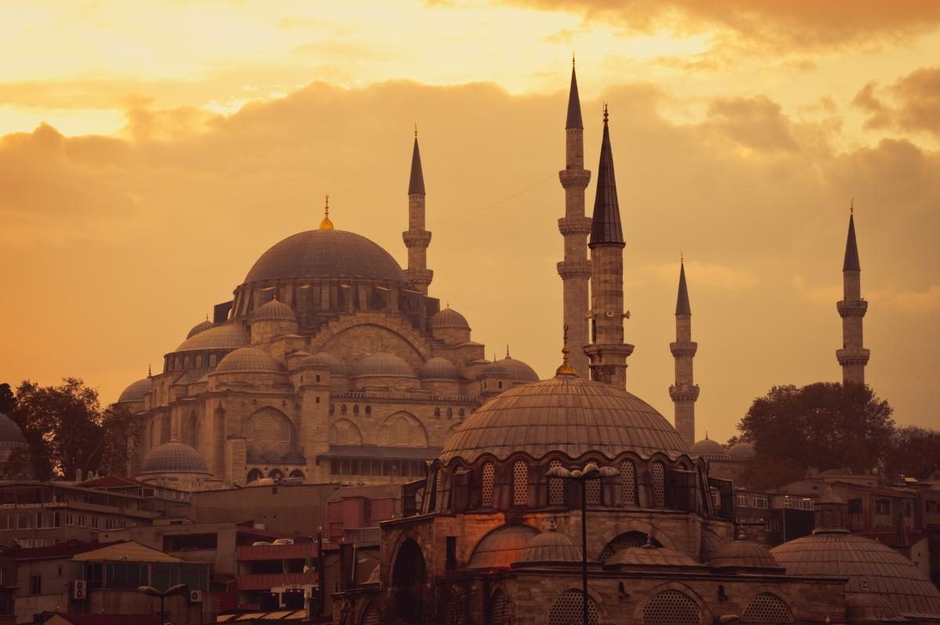
Who created
This holiday was established by Prophet Muhammad and is celebrated on the first day of the month of Shawwal to mark the conclusion of Ramadan.

Slide 8
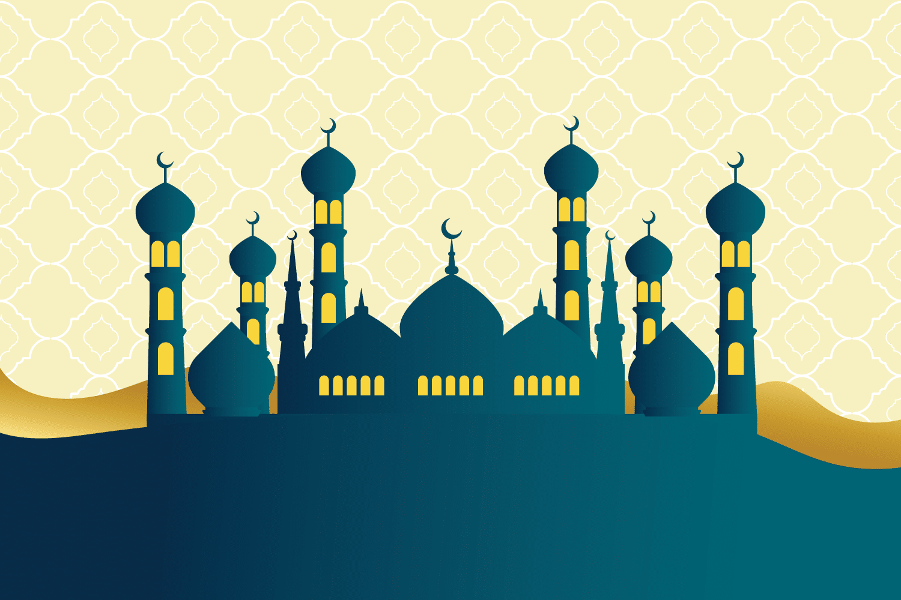
The beginning of the holiday
According to some beliefs, the festivals of Eid al-Fitr began in Medina after the Hegira (departure of Muhammad from Mecca) in 622 AD.

Slide 9
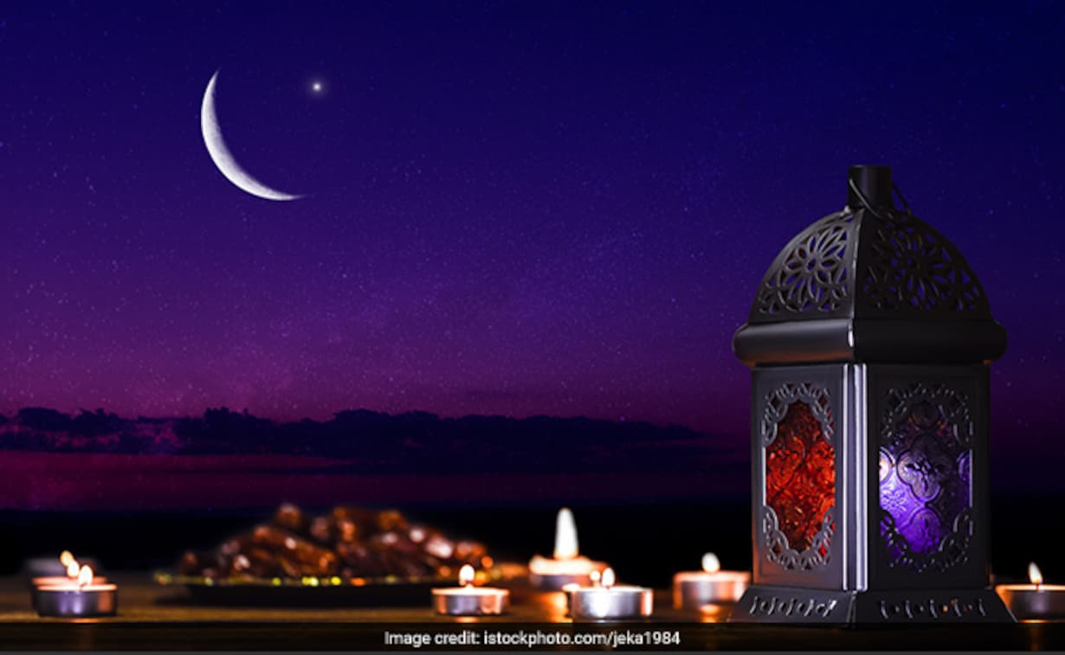
Conclusion

